Slide 1
Online Old Book shop
CSE 299.2
Group 6

Slide 2
Group 6
A.K. Rafiul Alam Chowdhury -1330350642
Ekramul Haque - 1611577042

Slide 3
Project Idea
We are going to develop a web based application for buying and selling old books online
Anyone can post an old book on our website for sell
Anyone can buy from our website
People can add their request for any book

Slide 4

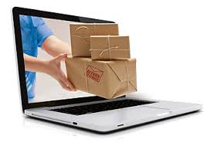
features
Users can open an account and using this account they can buy and sell books
They can upload the pictures of their for selling
People can buy books as well by using the buyers account

Slide 5
Benefits

Slide 6
1.
Sell Online
People can sell the books that they had already read

Slide 7
2.
Cheap cost
They can choose their favourite books in cheaper cost than other online book stores

Slide 8
What are we Going to use

Slide 9
FronEnd
HTML
CSS
JAVASCRIPT

Slide 10
BACKEND
RAW PHP
LARAVEL
MYSQL for database

Slide 11
THANK you!
Any questions?

